Slide 1

Personalized Learning Recommendation System
BCA · MACHINE LEARNING
BRAINWARE UNIVERSITY
An introduction to a terminal-based study recommender built with Python and the OULAD dataset
Student name
Roll / Student ID
Salim Ayman
BWU/BCA/24/080
Course
Department
BCA – Bachelor of Computer Application
Computational Science
Subject name
Machine Learning
Notes:
Good morning. My project is the Personalized Learning Recommendation System, submitted for BCA in Machine Learning at Brainware University. It turns a student’s marks into a clear study plan and also trains a Random Forest model on the OULAD learning dataset.

Slide 2
Introduction
Background
Overview
BCA, B.Tech, BBA and MCA students study many subjects, and every student has different strengths and weaknesses. After an exam they receive marks, but little guidance on what to revise first, for how long, or where to find good material.
Student enters course, subjects, marks, study hours and learning method
Program analyses the marks and ranks weak subjects
Topics with video and notes links, plus a 7-day planner
Random Forest model trained on the OULAD dataset
4
15
7
courses: BCA, B.Tech, BBA, MCA
subjects in every course
OULAD CSV files merged
Personalized Learning Recommendation System · Salim Ayman · BWU/BCA/24/080
2
Notes:
The project is a terminal program written in Python. A student enters marks and gets analysis, recommendations and a weekly plan. It also loads the OULAD dataset and trains a Random Forest classifier, which connects it to the Machine Learning subject.

Slide 3
Problem Statement
After an exam a student sees marks, but not what to study first, for how long, or where to find good material.
Marks without direction
One-size-fits-all schedule
No link between a mark and the exact topics that need revision.
Plans ignore the daily time available and the preferred learning style.
Time lost searching
No progress view
Students search the web for material of uncertain quality.
No easy way to compare one attempt with the previous one.
Need: instant, personal, actionable guidance built from the student’s own marks.
Personalized Learning Recommendation System · Salim Ayman · BWU/BCA/24/080
3
Notes:
Students receive marks but no next step. They do not know which topics to revise, how to fit study into their day, or how their latest attempt compares with the last one. This project closes that gap.

Slide 4
Objectives
1
Classify each subject into a clear proficiency level
2
Find weak subjects (below 60%) and rank them by urgency
3
Recommend topics with video and notes links
4
Build a personalised 7-day study planner
5
Adapt advice to the preferred learning method
6
Save every attempt and compare progress over time
7
Merge the OULAD files and train a Random Forest classifier
EXPECTED OUTCOME
A clear, personal path from marks to action
Personalized Learning Recommendation System · Salim Ayman · BWU/BCA/24/080
4
Notes:
Seven objectives, from classifying marks to training a machine-learning model. Together they should give the student a clear path from marks to action.

Slide 5
Scope of the Project
Coverage
Target users
Limitations
4 courses with 15 subjects each
Topic lists for 12 key subjects, generic topics for the rest
Marks, study hours and learning method
Analysis, 7-day plan, scenario and progress history
OULAD loading and Random Forest training
BCA, B.Tech, BBA and MCA students
Individual self-study guidance
Runs in the terminal with Python 3, pandas, NumPy, scikit-learn and joblib
No login: history is tied to the Student ID
One JSON file, not built for many users
Fixed rules for marks analysis
Model learns from OULAD, not from BCA marks
Resource links are searches, not curated
Personalized Learning Recommendation System · Salim Ayman · BWU/BCA/24/080
5
Notes:
Coverage is four courses with fifteen subjects each. The users are college students studying alone. The main limits are the lack of a login and the fact that the Random Forest is trained on OULAD, so it does not predict the student’s own subject marks.

Slide 6
Literature Review and Existing System
Existing approach | What it offers | Limitation
Grade cards and spreadsheets | Final marks | No guidance on what to revise; arrives late
Uniform lectures and textbook lists | Same advice for all | Ignores individual weak topics and study time
Self-search on the web | Unlimited material | Slow, uneven quality, no plan
Learning analytics on OULAD | Predicts results from scores and clicks | Research tool; not a student-facing guide
Gap: no simple tool links a student’s own marks to topics, time and progress.
Personalized Learning Recommendation System · Salim Ayman · BWU/BCA/24/080
6
Notes:
Existing approaches either give only marks or leave the student to plan alone. Research on educational data mining and the OULAD dataset shows that scores and activity can predict results, but those tools are not designed for an individual student. This project combines both ideas.

Slide 7






Proposed System
Validated input
Performance analysis
Recommendations
Course, six or more subjects, marks 0–100, study hours and method.
Five proficiency levels, average and ranked weak subjects.
3 to 5 topics per weak subject with video and notes links.
7-day planner
Improvement scenario
History and ML
Subjects rotate across the week using the daily hours entered.
A rule-based projected average, clearly not a prediction.
Progress saved in JSON; Random Forest trained on OULAD.
Personalized Learning Recommendation System · Salim Ayman · BWU/BCA/24/080
7
Notes:
The proposed system has six key features: validated input, performance analysis, recommendations, a seven-day planner, an improvement scenario and progress tracking with the OULAD model.

Slide 8
Project Methodology
Layer | Technology
Language | Python 3
Data handling | pandas, NumPy
Machine learning | scikit-learn: Pipeline, Random Forest
Storage | JSON file and OULAD CSV files; joblib model file
Interface | Terminal, no database server needed
Tools | VS Code, Python IDE
Development approach
Study requirements and design the modules
Build one function per task, step by step
Test each function with scripted input
Integrate the OULAD pipeline
Document and demonstrate
Personalized Learning Recommendation System · Salim Ayman · BWU/BCA/24/080
8
Notes:
The program is written in Python with pandas and NumPy for data, and scikit-learn for the machine-learning pipeline. There is no database server: progress goes to a JSON file, the dataset is read from CSV files, and the trained model is saved with joblib.

Slide 9
System Architecture
Presentation
Terminal menus and prompts
Tables and messages
Application logic
Student input
Performance analysis
Recommendation engine
7-day planner
Improvement scenario
Progress tracker
Machine learning
Load 7 CSV files
Preprocess and merge
Random Forest: train and evaluate
Data
COURSE_SUBJECTS and TOPIC_MAP
student_progress.json
OULAD CSV files
oulad_random_forest.pkl
A layered design: each layer talks only to the layer next to it, so topics, rules or models can change without touching the rest.
Personalized Learning Recommendation System · Salim Ayman · BWU/BCA/24/080
9
Notes:
The architecture has four layers. The terminal presentation layer collects input and prints results. The application logic layer holds six functions. The machine-learning layer loads the OULAD files and trains the Random Forest. The data layer holds the dictionaries, the JSON progress file, the CSV files and the saved model.

Slide 10

Workflow
1
2
3
4
Input
Validate
Analyse
Recommend
ID, course, 6+ subjects, marks, hours, method
Range checks; invalid input is asked again
Status per subject, average, weak list
3–5 topics with video and notes links
5
6
7
8
Plan
Scenario
Save and compare
OULAD model
7-day planner and weekly study target
Rule-based projected average
JSON history vs previous attempt
Load, merge, train Random Forest, save
Invalid input: fewer than 6 subjects or a mark outside 0–100 repeats the prompt.
No weak subject: encouraging message; the plan uses all subjects.
Dataset missing: the OULAD step is skipped without a crash.
Personalized Learning Recommendation System · Salim Ayman · BWU/BCA/24/080
10
Notes:
The program runs in eight steps. The first four deal with the student’s marks, steps five to seven build the plan and save progress, and step eight trains the model on OULAD. Three safety rules keep the program from crashing: repeated prompts for invalid input, a message when nothing is weak, and a safe skip when the dataset is missing.

Slide 11
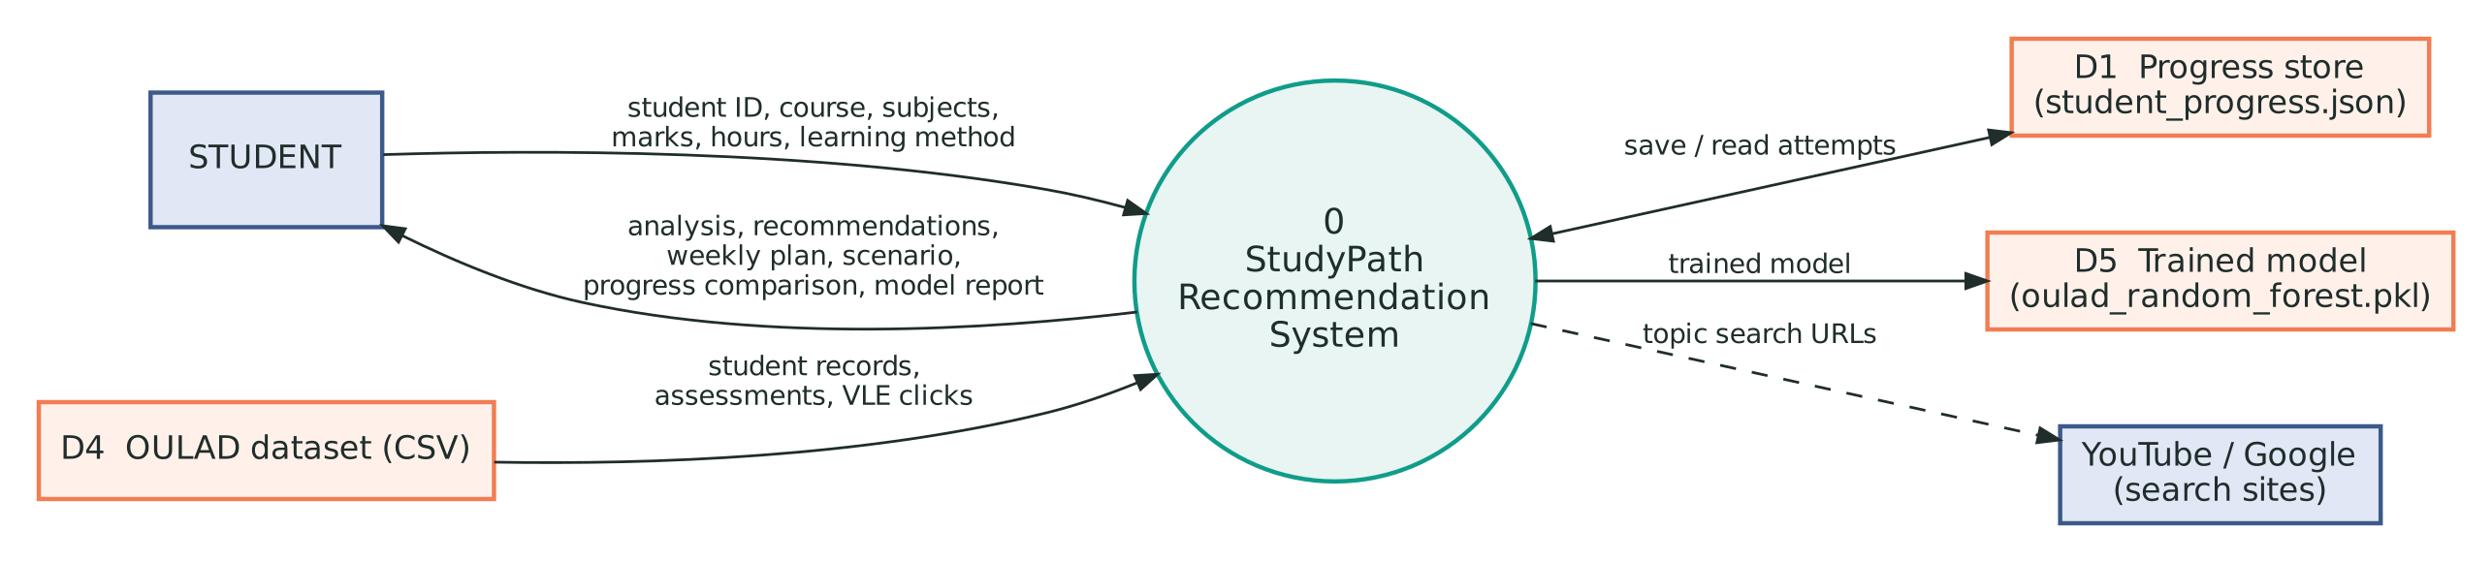
Data Flow
1.0 Collect and validate input
2.0 Analyse performance
3.0 Recommend topics
4.0 Weekly planner
5.0 Improvement scenario
6.0 Save and compare
7.0 OULAD model training
Stores: D1 progress, D2 topics, D3 courses, D4 OULAD, D5 model
Personalized Learning Recommendation System · Salim Ayman · BWU/BCA/24/080
11
Notes:
This is the Level 0 data flow diagram. The student gives input and receives analysis, recommendations, the plan and a progress comparison. The system reads and writes the progress store, reads the OULAD dataset and saves the trained model. Level 1 splits the system into the seven processes listed below the diagram.

Slide 12
Data Design
OULAD group | Features in the merged table
Profile | gender, region, education, age band, previous attempts, credits, disability
Assessment | average score, assessment count, late submissions
VLE activity | total clicks, active days, unique resources
Course and registration | presentation length, registration and un-registration dates
Target | final_result: Distinction, Pass, Fail or Withdrawn
Progress store: student_progress.json
{
"BWU/BCA/24/080": [
{
"course": "BCA",
"marks": {
"Python Programming": 72.0,
"Data Structures": 38.0, ...
},
"average": 59.5
}
]
}
Personalized Learning Recommendation System · Salim Ayman · BWU/BCA/24/080
12
Notes:
There is no database server. Student history is a JSON file keyed by Student ID, and each attempt stores the course, marks and average. For the machine-learning part, seven OULAD files are merged into one table per student and module presentation, with final_result as the target.

Slide 13
Implementation: Major Modules
Function | Purpose
analyze_performance() | Status per subject, average, weak list
generate_recommendations() | Priority, 3–5 topics, video and notes links
create_study_plan() | 7-day rotation and weekly target
improvement_scenario() | Rule-based projected average
save_progress() | JSON history and comparison
preprocess_oulad_data() | Merge 7 CSV files into features
train_oulad_model() | Train, evaluate and save the model
Random Forest pipeline
model = Pipeline([
("preprocessor", preprocessor),
("classifier", RandomForestClassifier(
n_estimators=150,
random_state=42,
class_weight="balanced"))
])
model.fit(X_train, y_train)
joblib.dump(model, MODEL_FILE)
Personalized Learning Recommendation System · Salim Ayman · BWU/BCA/24/080
13
Notes:
The code in f1.py is divided into numbered steps, one function per task. The right side shows the Random Forest pipeline: missing values are filled, categories are one-hot encoded, a forest of 150 trees with balanced class weights is trained on 80 percent of the data, tested on 20 percent, and the whole pipeline is saved with joblib.

Slide 14
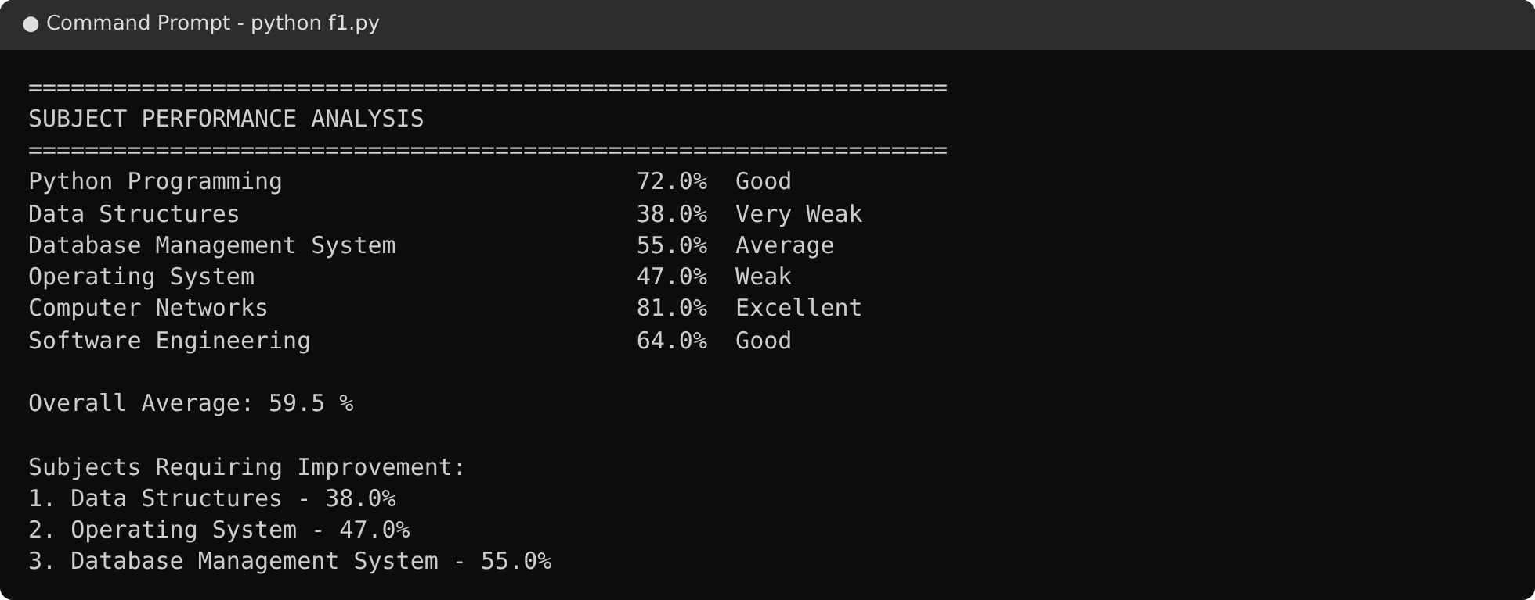
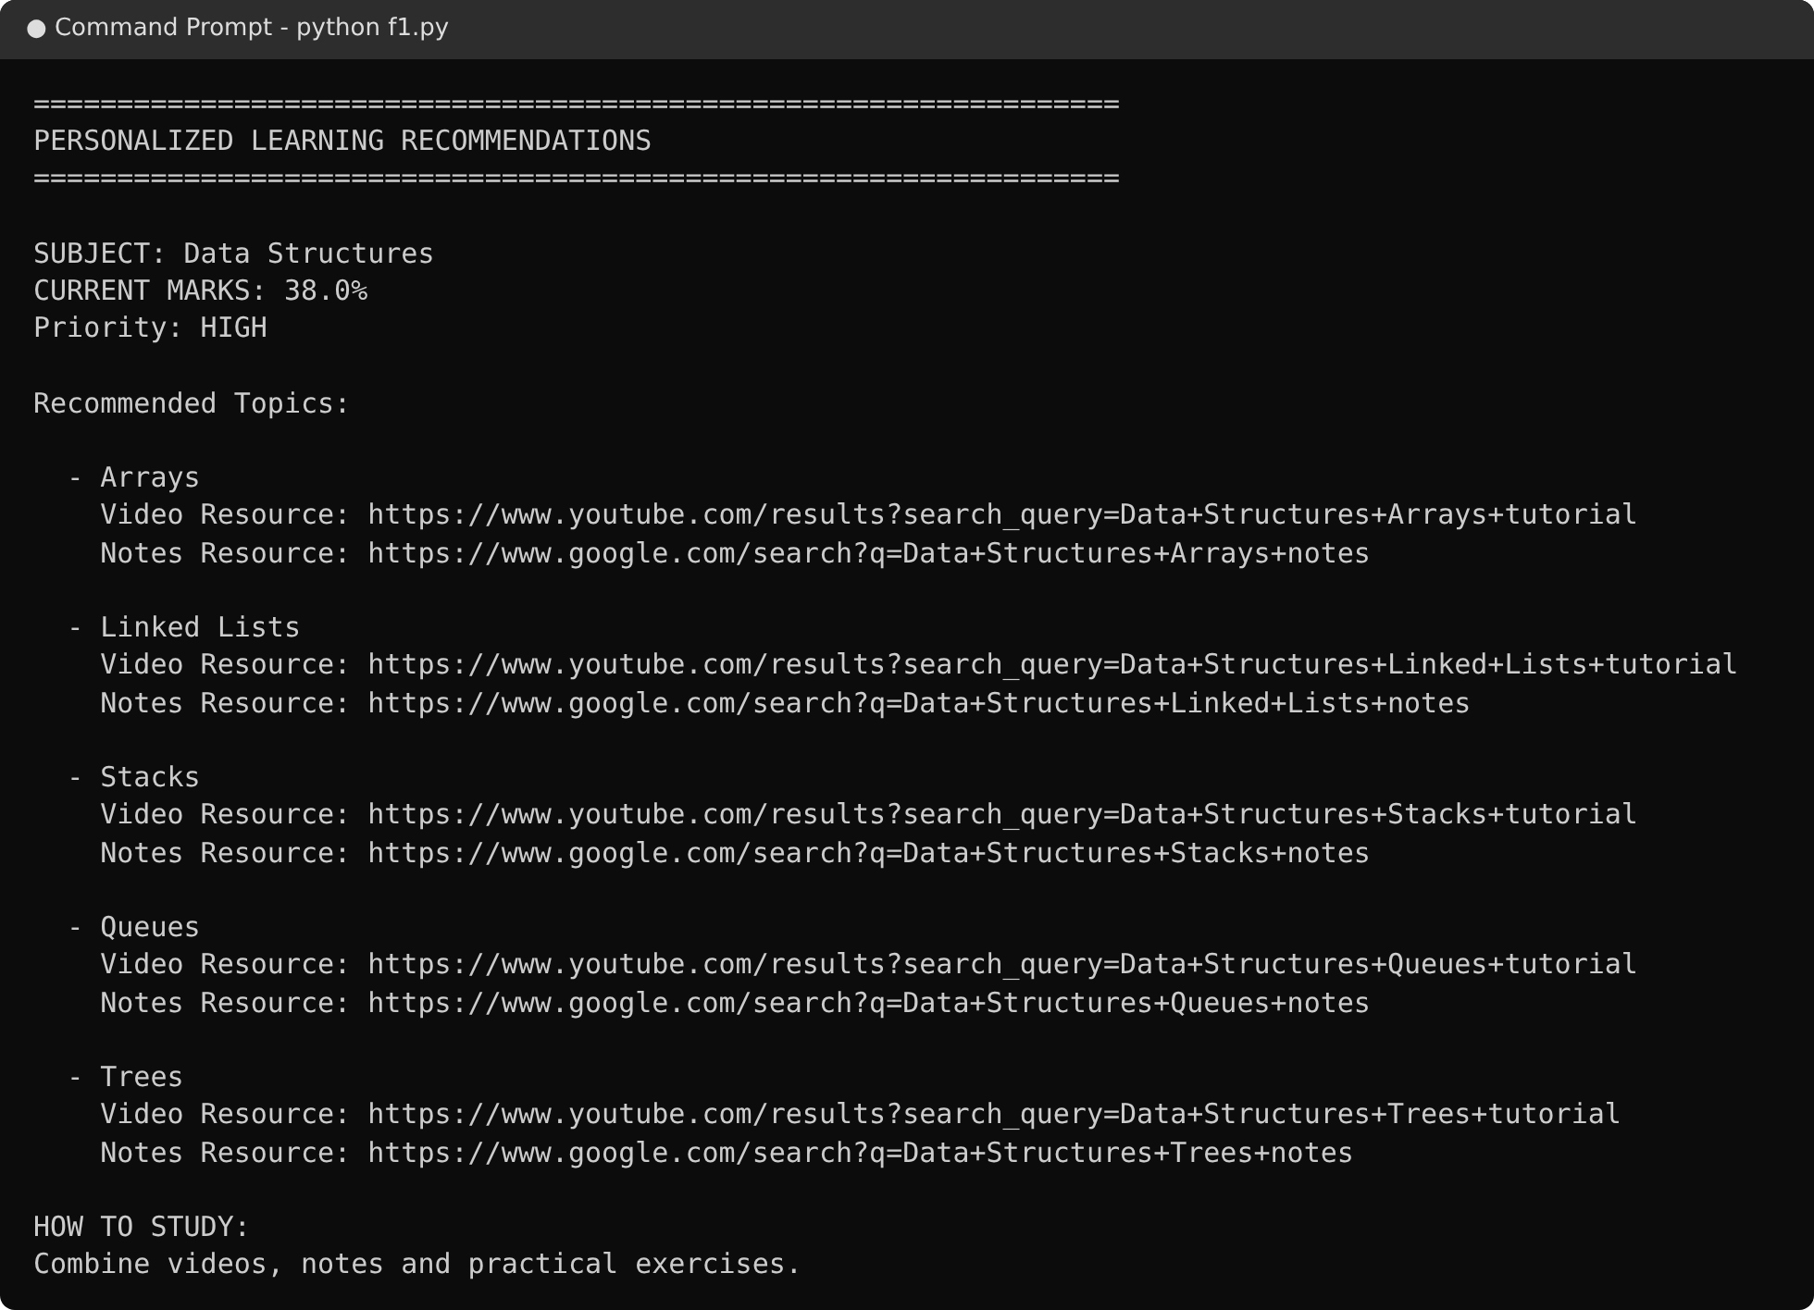
Implementation: Analysis and Recommendations
Performance analysis
Six subjects get a status; the average is 59.5% and three weak subjects are ranked: Data Structures 38%, Operating System 47%, DBMS 55%.
Recommendations
Personalized Learning Recommendation System · Salim Ayman · BWU/BCA/24/080
14
Notes:
Real output from the running program for a BCA student. The analysis classifies each subject and lists the weak ones in order. For Data Structures at 38 percent the priority is high and five topics are recommended, each with a YouTube video search and a Google notes search.

Slide 15
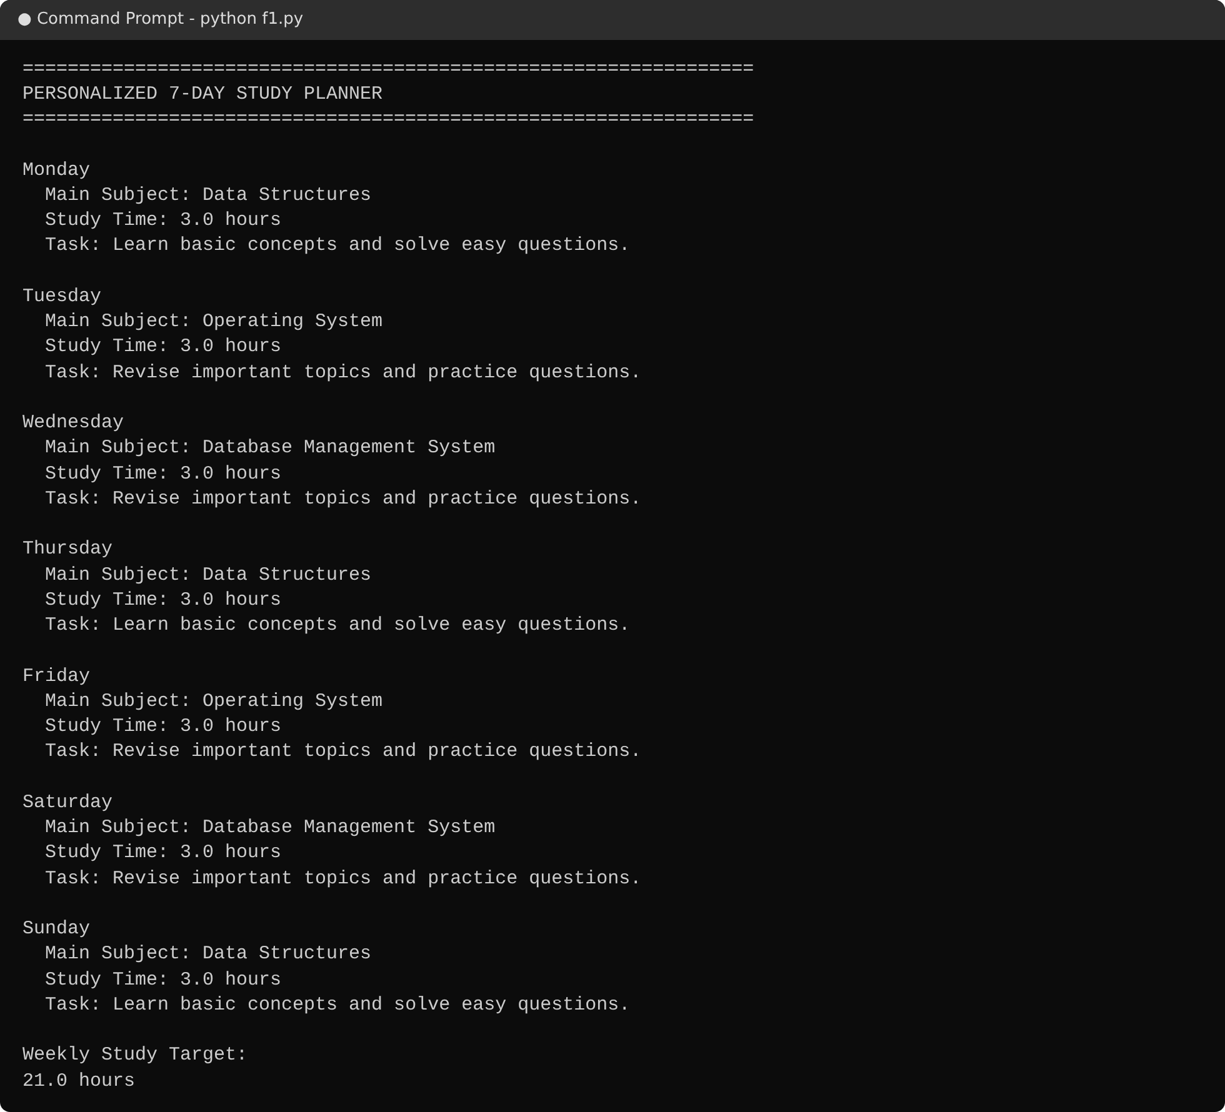
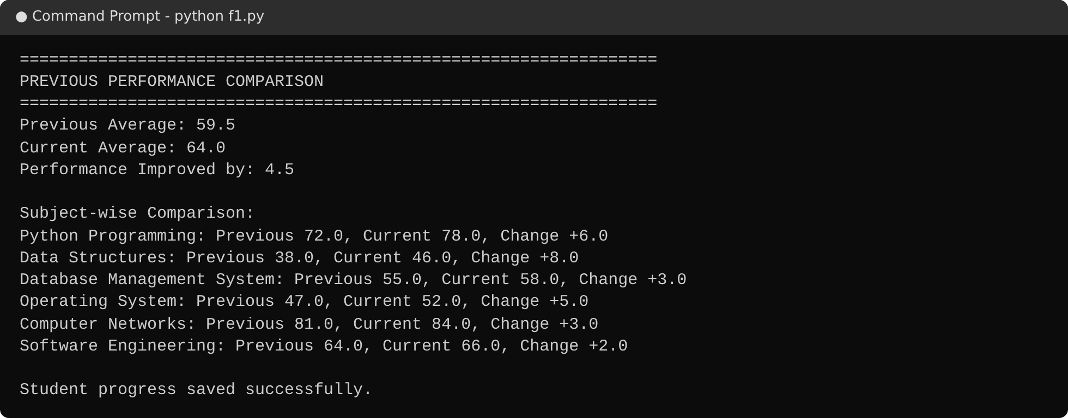
Implementation: Planner and Progress
Progress comparison
A second attempt of the same Student ID is compared with the first: the average rose from 59.5 to 64.0 and every subject improved.
7-day study planner
Personalized Learning Recommendation System · Salim Ayman · BWU/BCA/24/080
15
Notes:
The planner rotates the weak subjects across the seven days using the three study hours entered, for a weekly target of 21 hours. After a second attempt, the program reads the saved JSON history and prints the change in the average and in each subject.

Slide 16
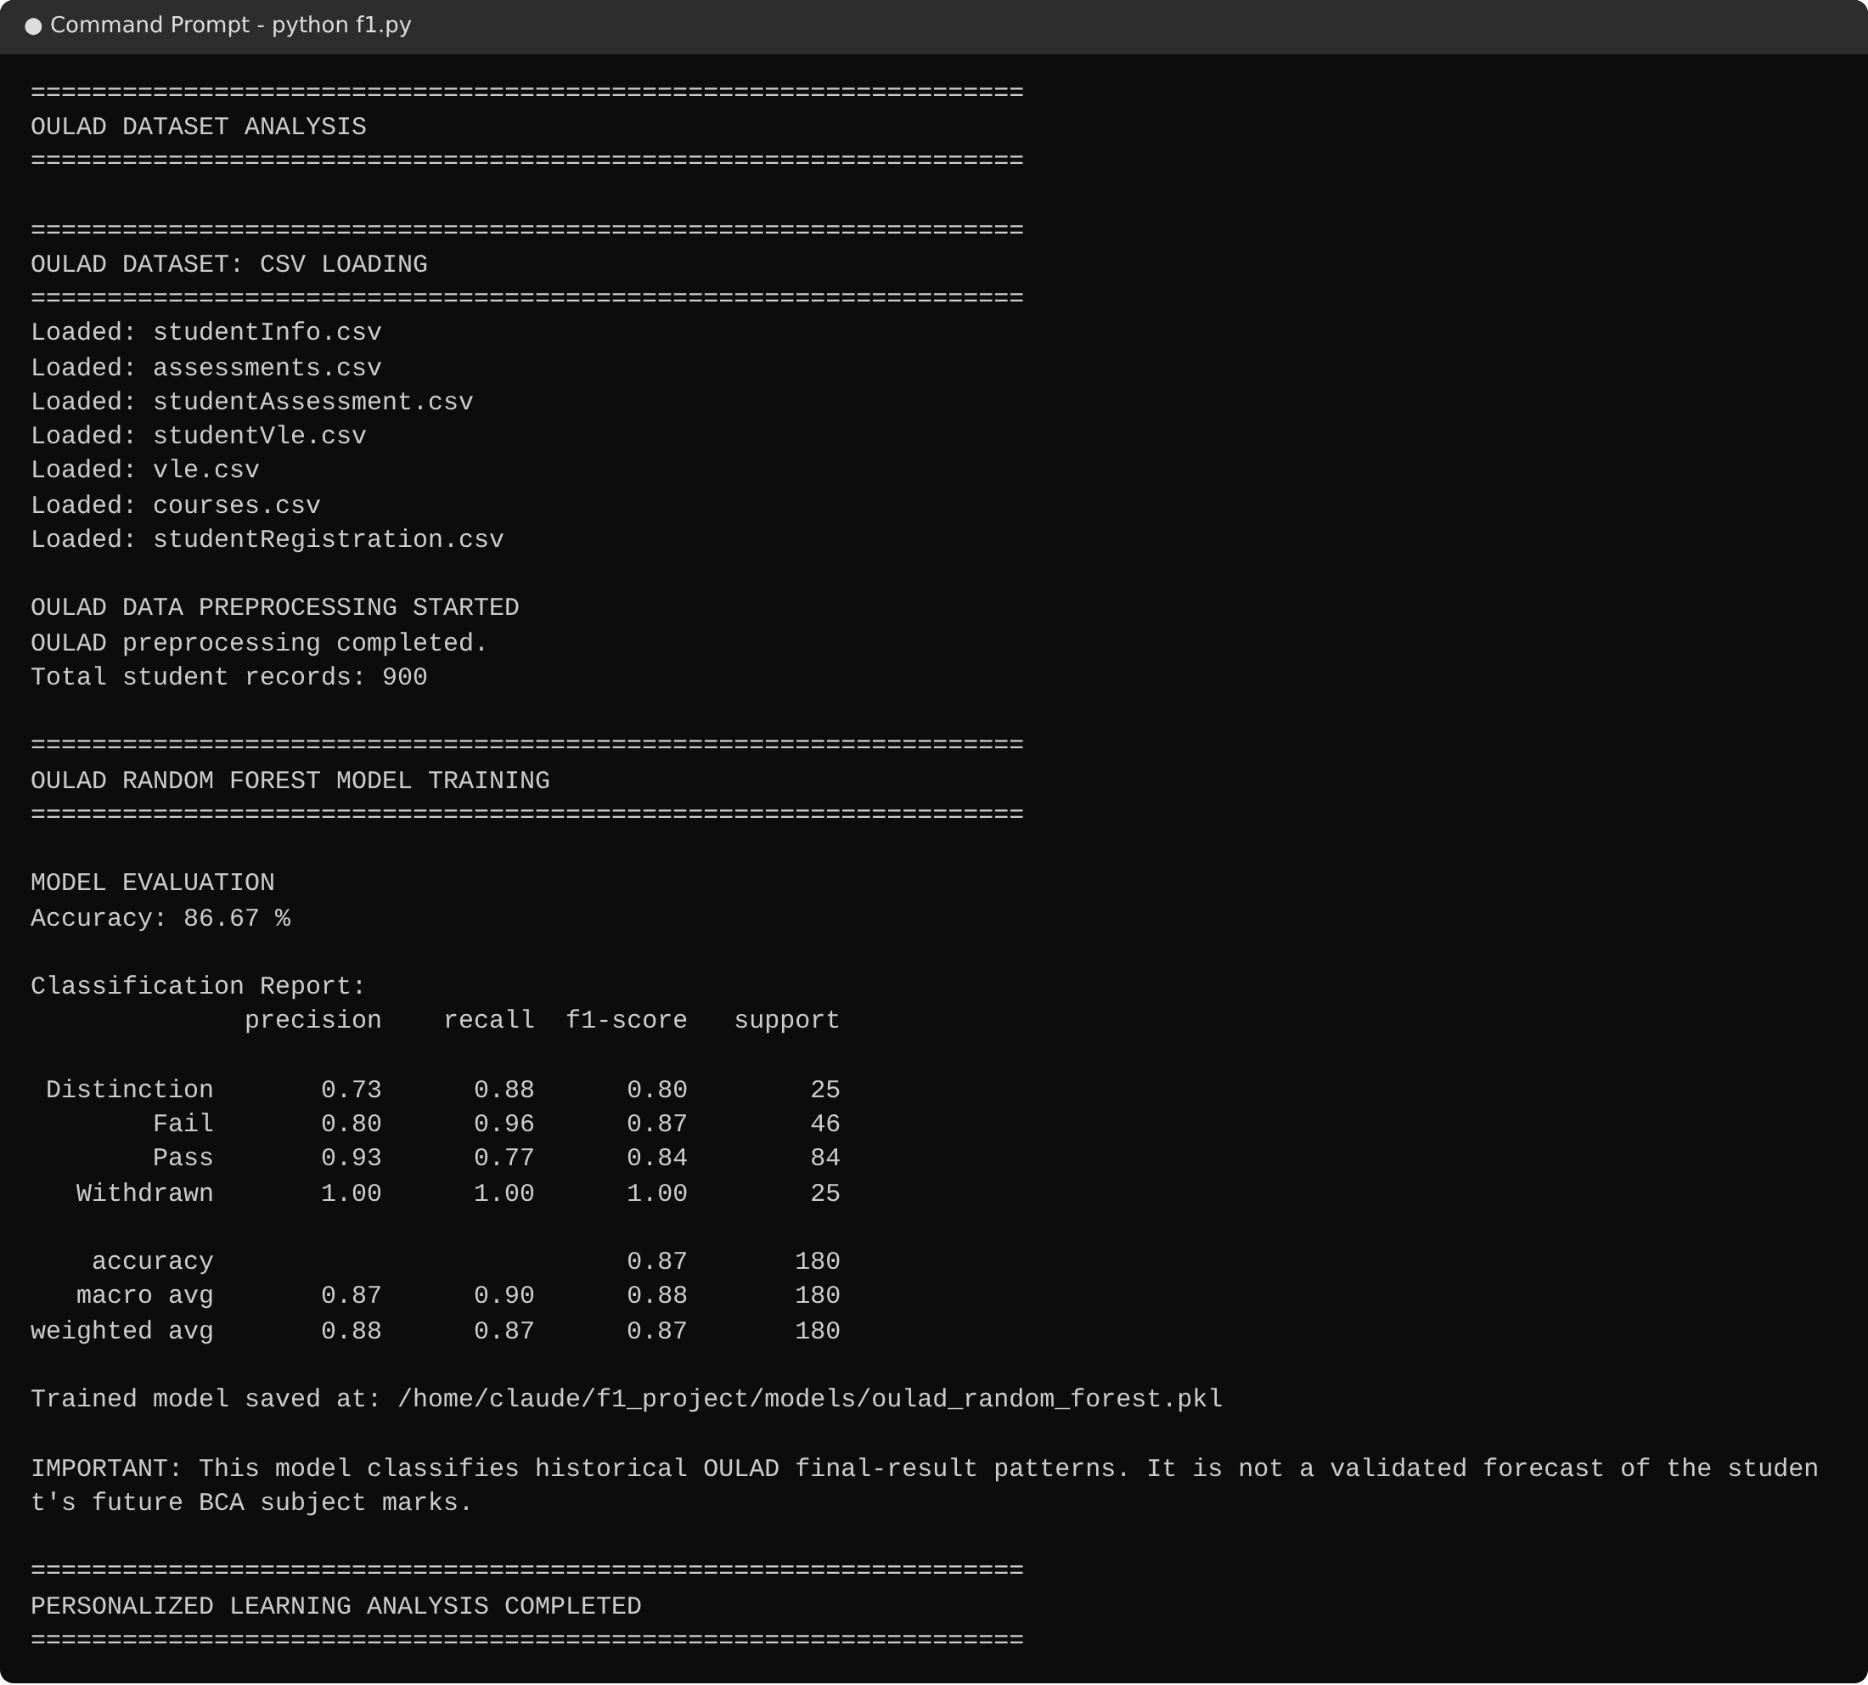
Implementation: OULAD and Random Forest
What the program does
Loads 7 OULAD CSV files with pandas
Merges assessment, activity and registration data per student
Trains 150 trees with balanced class weights
Prints accuracy, precision, recall and F1-score
Saves the model as a .pkl file
Screenshot taken on a small sample dataset with the OULAD file structure. Results on the full OULAD dataset will differ.
Personalized Learning Recommendation System · Salim Ayman · BWU/BCA/24/080
16
Notes:
This is the machine-learning stage. The seven CSV files are loaded and merged into one record per student, and a Random Forest is trained to classify the final result: Distinction, Pass, Fail or Withdrawn. The screenshot comes from a small sample dataset with the OULAD structure, so replace it with a run on the full dataset before the final submission.

